Slide 1
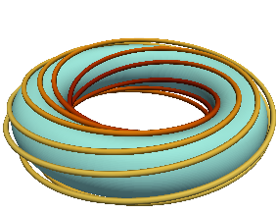



(a) Eulerian frame
Domain is fixed in time.
(c) 2D co-moving frame & remap
Domain deforms, but the remap rolls it back.
$$y$$
$$z$$
$$x$$
(b) 2D co-moving frame
Domain continuously deforms by shear flow.
(d) Rotating flux-tube model
Shear-flow-induced deformation is canceled
by magnetic shear.
Flux-tube rotates on a torus.

Slide 2
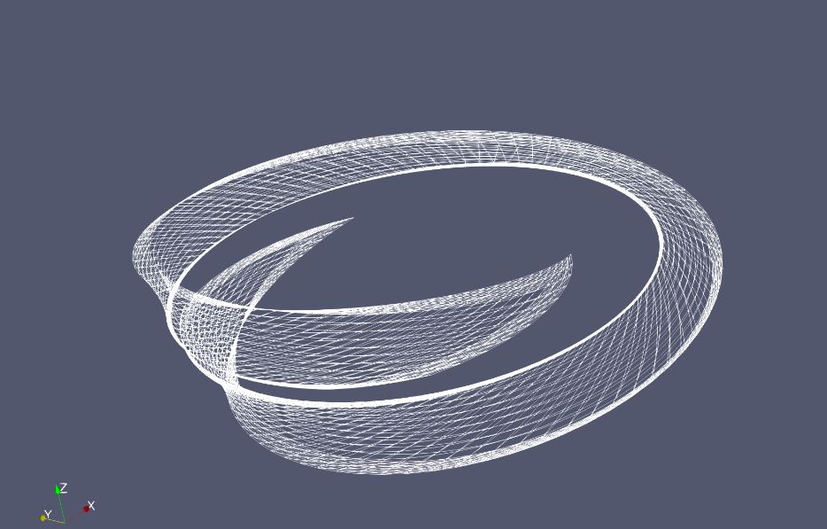
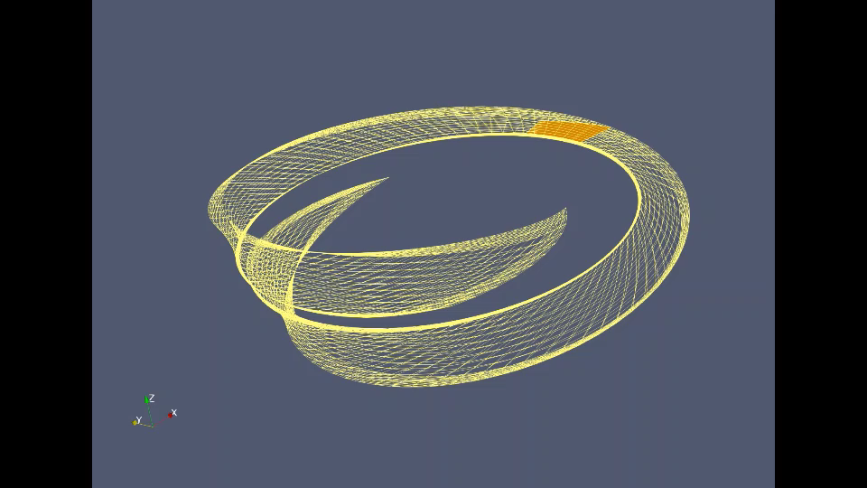
(a) Eulerian frame
Domain is fixed in time.
(c) 2D co-moving frame & remap
Domain deforms, but the remap rolls it back.
(b) 2D co-moving frame
Domain continuously deforms by shear flow.
(d) Rotating flux-tube model
Shear-flow-induced deformation is canceled
by magnetic shear.

